Slide 1
Thinking about light as a wave, interacting with a charged particle
-

Slide 2
Thinking about light as a wave, interacting with a charged particle
-

Slide 3
Thinking about light as a wave, interacting with a charged particle
-

Slide 4
Thinking about light as a wave, interacting with a charged particle
-

Slide 5
Thinking about light as a wave, interacting with a charged particle
-

Slide 6
Thinking about light as a wave, interacting with a charged particle
-

Slide 7
Thinking about light as a wave, interacting with a charged particle
-

Slide 8
Thinking about light as a wave
-

Slide 9
Thinking about light as a wave, interacting with a charged particle
-

Slide 10
Thinking about light as a wave, interacting with a charged particle
-

Slide 11
Thinking about light as a wave, interacting with a charged particle
-

Slide 12
Thinking about light as a wave, interacting with a charged particle
-

Slide 13
Thinking about light as a wave, interacting with a charged particle
-

Slide 14
Thinking about light as a wave, interacting with a charged particle
-

Slide 15
Thinking about light as a wave, interacting with a charged particle
-

Slide 16
Thinking about light as a wave, interacting with a charged particle
-

Slide 17
Thinking about light as a wave, interacting with a charged particle
-

Slide 18
Thinking about light as a wave, interacting with a charged particle
-

Slide 19
Thinking about light as a wave, interacting with a charged particle
-

Slide 20
Thinking about light as a wave, interacting with a charged particle
-

Slide 21
Thinking about light as a wave, interacting with a charged particle
-

Slide 22
We associate wavelength of light with the color of light
Red light:
𝝀=700 nm
Violet light:
𝝀=300 nm

Slide 23
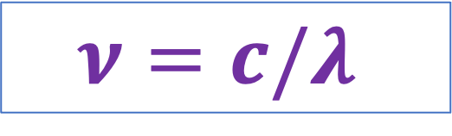
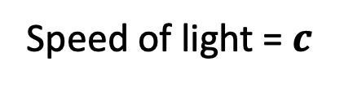
Associated with each wavelength is a frequency
Speed of light = $c$
Frequency-wavelength equation:
$$ν=c/λ$$

Slide 24
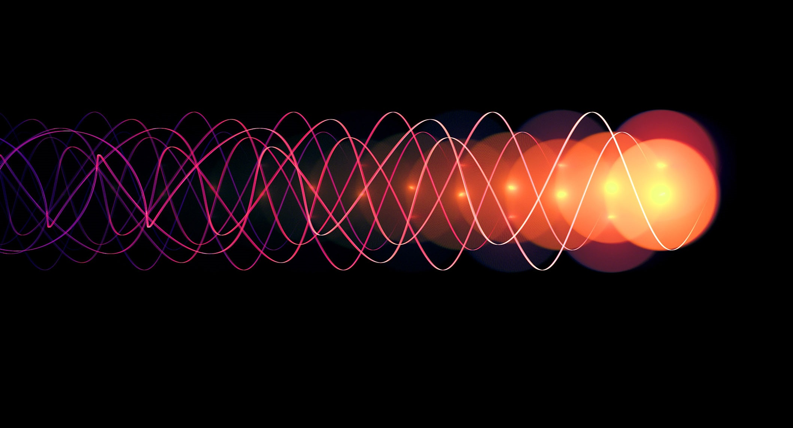

But we also think about photons of light – like little particles of energy
Energy-frequency equation:
$$E_{photon}=hν$$

Slide 25
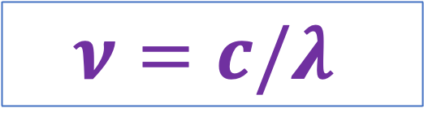
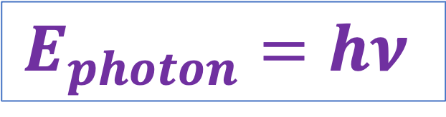
Wave-particle duality (thinking about light as a wave and a particle)
Speed of light
$$E_{photon}=hν$$
$$ν=c/λ$$

Slide 26

Wave-particle duality (thinking about light as a wave and a particle)
Speed of light
$$E_{photon}=hν$$
$$ν=c/λ$$
$$E_{photon}=hc/λ$$
Wave-particle duality equation

Slide 27
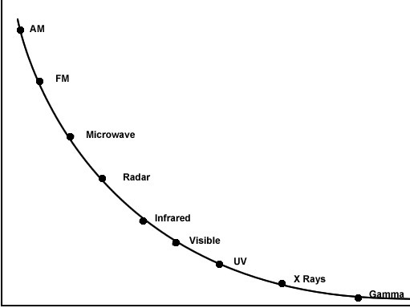



Visualizing the wave-particle duality equation
$$λ$$
$$E_{photon}=hc/λ$$
$$E_{photon}$$

Slide 28
The direction of acceleration …
The direction of acceleration is perpendicular to the path (beam) of the light
Red light:
Photon energy = $1.8 eV$
+
Not this
+
Violet light:
Photon energy = $3.6 eV$
There are actually two perpendicular directions possible
https://en.wikipedia.org/wiki/Light#/media/File:Light_dispersion_conceptual_waves.gif

Slide 29
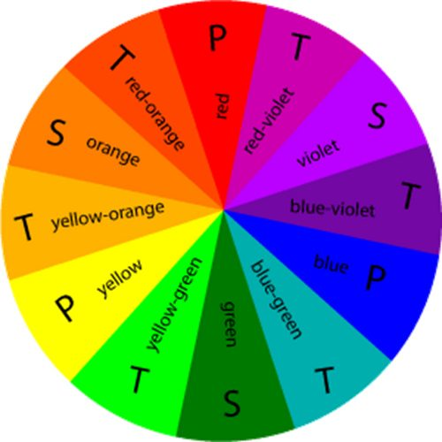
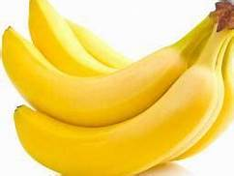
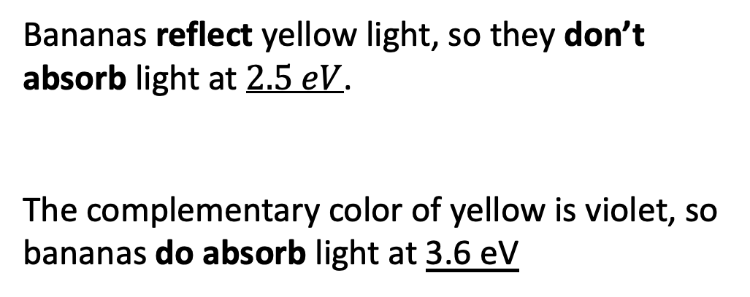
Complementary colors …
Bananas reflect yellow light, so they don’t absorb light at $2.5 eV$.
The complementary color of yellow is violet, so bananas do absorb light at 3.6 eV
1.8 eV
2.1 eV
3.6 eV
3.3 eV
2.4 eV
2.7 eV
3.0 eV

Slide 30
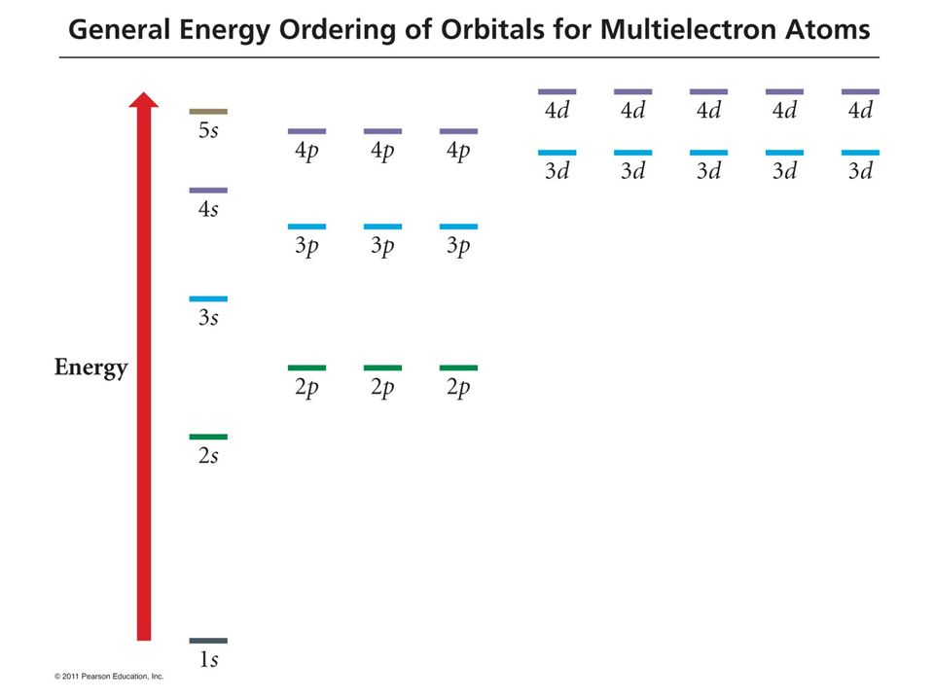
Absorption of energy to promote an electron can happen in multiple ways
What supplies the energy to do this?
A flame
Electrical current in a Geißler tube
Cosmic rays from the sun
A photon of light having the same energy (E_{photon})
Even some chemical reactions
HOMO

Slide 31
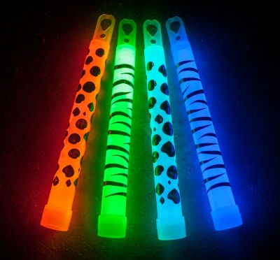
Absorption of energy to promote an electron can happen in multiple ways
What supplies the energy to do this?
A flame
Electrical current in a Geißler tube
Cosmic rays from the sun
A photon of light having the same energy (E_{photon})
Even some chemical reactions
HOMO
Glow sticks

Slide 32
Temporary lingering of an excited state
Usually, this excited-state situation lasts only a tiny fraction of a second – but in some cases (like glow sticks) it can last for hours!

Slide 33

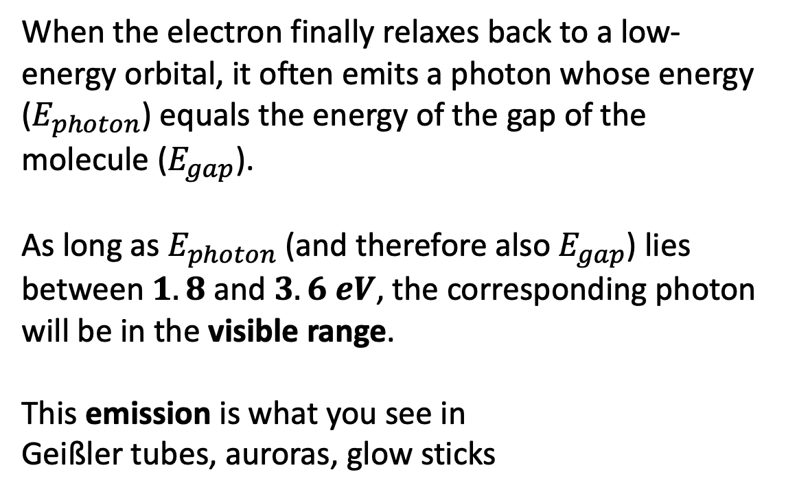
Emission
When the electron finally relaxes back to a low-energy orbital, it often emits a photon whose energy ($E_{photon}$) equals the energy of the gap of the molecule ($E_{gap}$).
As long as $E_{photon}$ (and therefore also $E_{gap}$) lies between $1.8 \text{and} 3.6 eV$, the corresponding photon will be in the visible range.
This emission is what you see in
Geißler tubes, auroras, glow sticks
$$E_{gap}$$

Slide 34
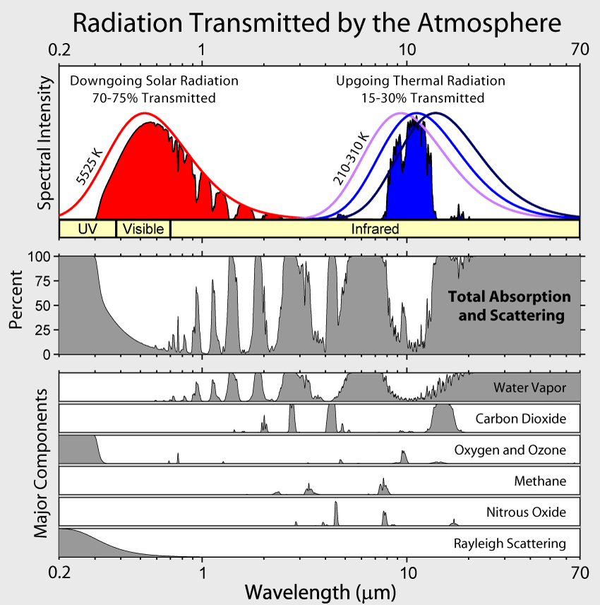
Blackbody Spectra and Wien’s Law
Wien’s Law: $T=\frac{k}{λ_{max}}$
where $k=2900 μm∙K$, $λ_{max}$ is in $μm$, and $T$is the temperature (K) of the blackbody

Slide 35
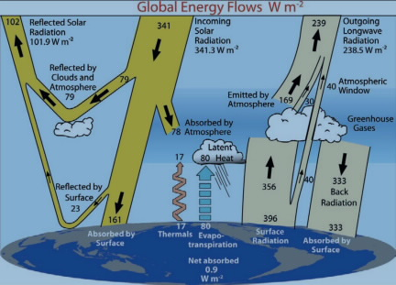
Recap of planetary radiative balance
Shortwave energy comes in, with a good fraction (30%) being reflected away before it’s absorbed by the planet. This 30% is called the planetary albedo.
Longwave energy is emitted by the surface, most of which is captured by the atmosphere on its way out. Then a lot of longwave is back-radiated to the surface from the atmosphere (check out the numbers).
Climate change happens when the planet gets out of radiative balance. There are albedo changes (Arctic ice is disappearing) but primarily, this has occurred because the atmosphere is capturing more longwave surface radiation.
Shortwave
Longwave
https://static.skepticalscience.com/pics/Global_Energy_Flows.jpg

Slide 36
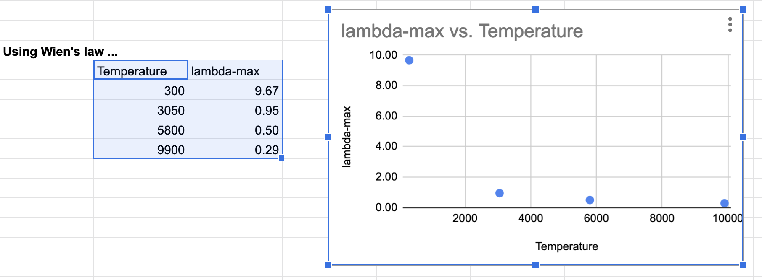
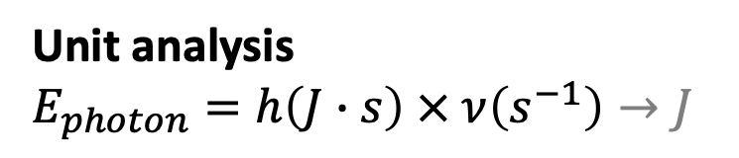
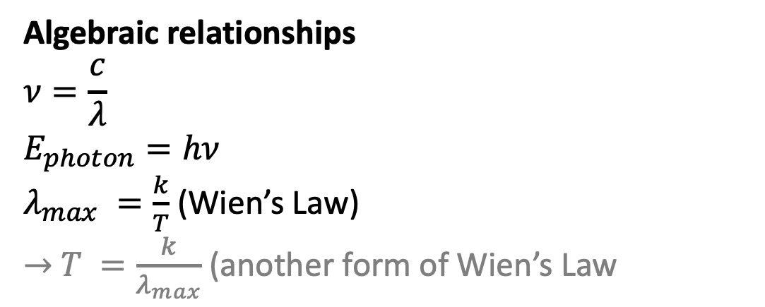
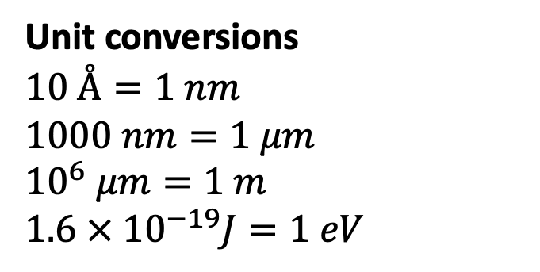
Lab skills
Unit conversions
$$10 Å=1 nm$$
$$1000 nm=1 μm$$
$$10^{6} μm=1 m$$
$$1.6 × 10^{−19}J=1 eV$$
Algebraic relationships
$$ν=\frac{c}{λ}$$
$$E_{photon}=hν$$
$λ_{max} =\frac{k}{T}$ (Wien’s Law)
$→$ $T =\frac{k}{λ_{max}}$ (another form of Wien’s Law
Unit analysis
$$E_{photon}=h\left(J∙s\right) × ν\left(s^{−1}\right)→J$$
Fill-down
Graphing

